Slide 1
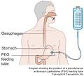
Students with Gastrostomy tubes
(G-tubes)

Slide 2
Gastrostomy Tubes(G-tubes)
A gastrostomy tube is a safe and simple way of giving food, medicines and fluids directly into the stomach

Slide 3
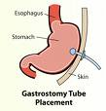
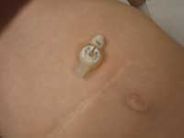
Gastrostomy Tubes(G-tubes)
A flexible rubber tube is inserted into a surgical opening into the stomach
It is held in place from inside the abdomen with a fluid filled balloon
It is usually capped or clamped between feedings to prevent leakage

Slide 4
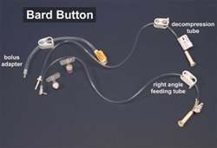
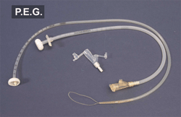
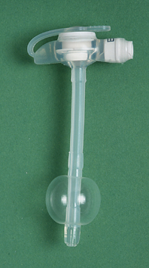
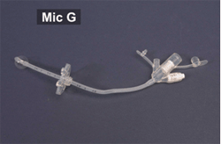
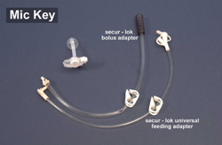
Gastrostomy Tubes(G-tubes)
There are several types of G tubes

Slide 5
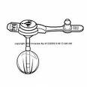
Mic-key
Low Profile Feeding tube

Slide 6
POSSIBLE PROBLEM REQUIRING IMMEDIATE INTERVENTION
Color changes/breathing difficulty
This may be due to aspiration of feeding or water into lungs. Stop feeding immediately. Call parent. If problem continues, follow emergency instructions in the care plan.

Slide 7
POSSIBLE PROBLEMS THAT ARE NOT EMERGENCIES
Nausea and or cramping
  Pause/stop feeding.
  Check rate of feeding – it may need to be decreased. Adjust rate of feeding only if indicated in care plan. Contact parent
  Check temperature – feeding may be too cold.
    let feeding get to room temperature if cold, then restart. If problem continues, stop feeding and contact parent

Slide 8
POSSIBLE PROBLEMS THAT ARE NOT EMERGENCIES
Vomiting
  Stop feeding.
  Check temperature of feeding fluid
  Check flow rate
  If flow rate was too fast, adjust only if written in care plan, then restart. Stop if vomiting continues
  If feeding was too cold, allow to come to room temperature, then restart. Stop if vomiting resumes

Slide 9
POSSIBLE PROBLEMS THAT ARE NOT EMERGENCIES
Blocked gastrostomy device
  May be due to inadequate flushing or very thick liquid. Be sure to flush with water before and after feedings. If blockage remains, contact family.

Slide 10
POSSIBLE PROBLEMS THAT ARE NOT EMERGENCIES
Bleeding/drainage/redness/irritation
  Parents are responsible to send student to school with a clean dry dressing around gastrostomy site
  If there is any leaking (clear fluid) around MIC-KEY please contact parent- it may indicate a problem with internal balloon that secures device.
  If there is any blood observed, check to see if G-tube has been dislodged. If not, reinforce dressing with gauze and call parent.

Slide 11
POSSIBLE PROBLEMS THAT ARE NOT EMERGENCIES
Leaking of stomach contents
  May be due to a problem with the antireflux valve (sticking or broken) Apply gauze and notify family

Slide 12

G-tube dislodgement
No need to panic, really.

Slide 13
G-Tube dislodgement- not life threatening
If a G tube device comes out of a student’s abdomen it needs to be replaced within a specific time frame or opening(stoma) begins to close
  Children with recent placed G-tubes must have it replaced quickly
    follow the Health Care Plan
  Children with older G-tubes have a longer time frame
    call the parent
    Call 911 if parent unavailable

Slide 14
If G-Tube Comes Out
Remember, don’t panic. This is not a life threatening emergency
Cover the G-tube opening with gauze(found in the student’s emergency bag)
The parent is usually the first choice to replace the G tube
Call 911 ONLY if you are not able to contact parent- follow the Health Care Plan
  Place old G-tube in the student’s bag

