Slide 1

Title IX:
Give Everyone a Sporting Chance.

Slide 2


Title IX provides that . . .
“[n]o person in the United States shall, on the basis of sex, be excluded from participation in, be denied the benefits of, or be subjected to discrimination under any education program or activity receiving Federal financial assistance . . . “
Notes:
The definition of a program or activity under Title IX is broad and encompasses a range of state or government entities associated with education, but to fall under Title IX it must be a program or activity as defined in the statute and a recipient of federal funds. And, federal funding may be direct or indirect

Slide 3

Title IX is enforceable . . .
OCR can take away federal funding and private parties can bring causes of action against the recipients of federal funds.
Notes:
For that reason, The Supreme Court has recognized an implied private right of action under Title IX when a recipient of federal funding fails to respond to sexual harassment. The Supreme Court has consistently interpreted Congress’s intent in enacting Title IX must have envisioned that private plaintiff’s would bring constitutional claims to challenge gender discrimination.

Slide 4

Title IX and Athletics

Slide 5
Equal Opportunity:
A recipient which operates or sponsors interscholastic, intercollegiate, club or intramural athletics shall provide equal athletic opportunity for members of both sexes.
Selection of Sports
Equipment
Scheduling
Travel
Coaching
Locker rooms and facilities
Publicity
Notes:
The definition of a program or activity under Title IX is broad and encompasses a range of state or government entities associated with education, but to fall under Title IX it must be a program or activity as defined in the statute and a recipient of federal funds. And, federal funding may be direct or indirect

Slide 6
SELECTION OF SPORTS:
THREE PART TEST
The number of male and female athletes is substantially proportionate to their respective enrollments; or
The institution has a history and continuing practice of expanding participation opportunities responsive to the developing interests and abilities of the underrepresented sex;
The institution is fully and effectively accommodating the interests and abilities of the underrepresented sex.
Notes:
The definition of a program or activity under Title IX is broad and encompasses a range of state or government entities associated with education, but to fall under Title IX it must be a program or activity as defined in the statute and a recipient of federal funds. And, federal funding may be direct or indirect

Slide 7


Office of Civil Rights, Department of Education
Dear Colleague Letters

Slide 8
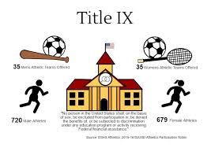
PROPORTIONALITY
Whether participation for male and female students are provided in numbers substantially proportionate to their respective enrollments.
Notes:
Congress enacted Title IX in 1972 with two principal objectives in mind (1) to avoid the use of federal resources to support discriminatory practices and (2) to provide individual citizens effective protection against those practices. When Congress acts pursuant to its spending power, it generates legislation much in the nature of a contract: in return for federal funds, the States agree to comply with federally imposed conditions. "The contractual framework of Title IX distinguishes Title IX from Title VII. Title VII is framed not as a contract but as an outright prohibition and is targeted toward discrimination in the economy. Title IX focuses more on “protecting” individuals from discriminatory practices carried out by recipients of federal funds. Title IX contractual nature stems out of Congress attaching conditions to the award of federal funds under its spending power. For this reason, the Supreme Court found recipients of the federal funds are liable for noncompliance with the conditions.

Slide 9
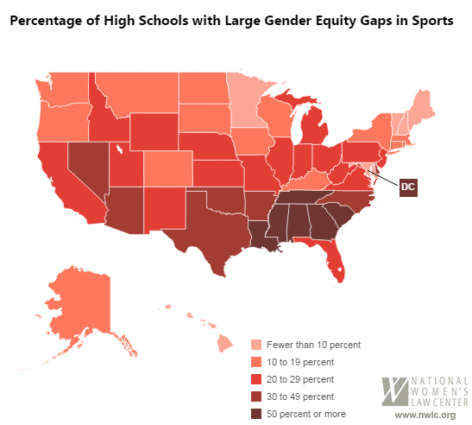

Slide 10

History & Continuing Practice
Adding new sports
Increasing number of participants
Responding to requests to add new sports

Slide 11
EFFECTIVE ACCOMMODATION TEST
Unmet Interest
Sufficient Ability
Reasonable Expectation of Interest

Slide 12

Assessing Interest
Look at indicators of interest: participation in club, high schools, intramural, and community teams in an institution’s boundaries, and requests for the elevation of an existing club sport.

Slide 13
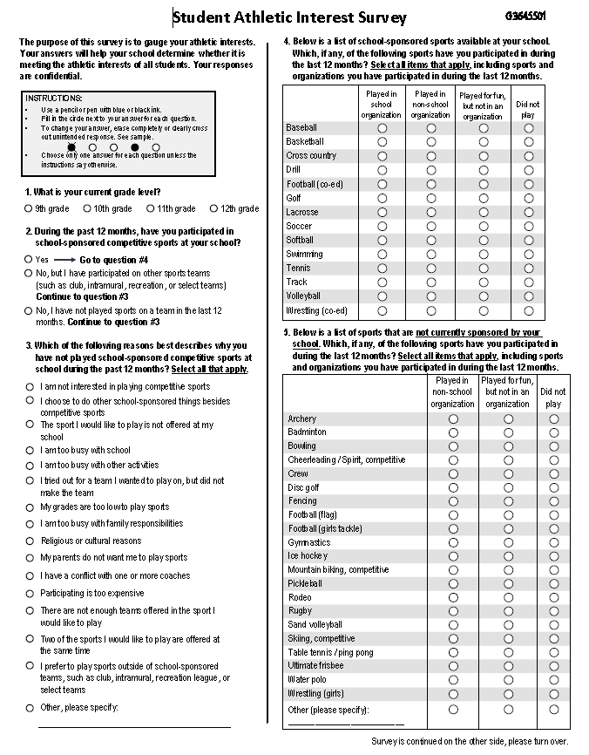
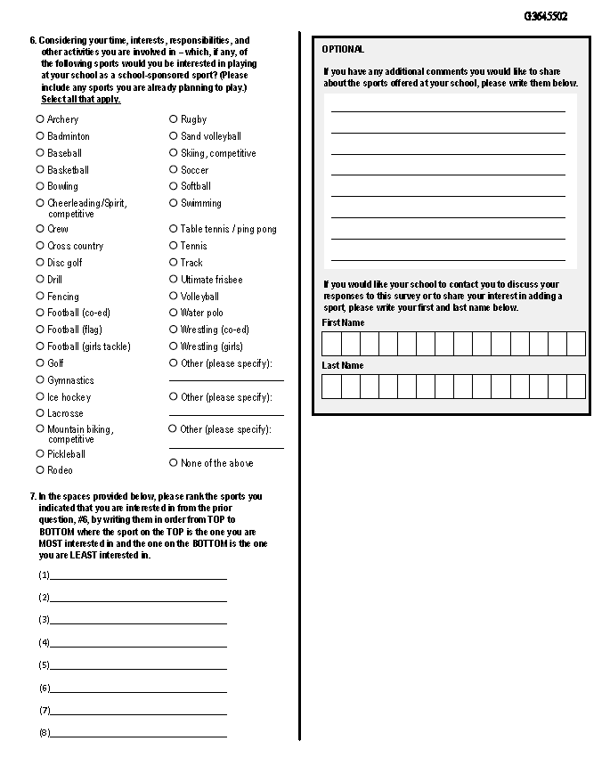
SURVEY SAYS!

Slide 14
Reasonable Expectation of Competition?
Looks to normal competitive region

Slide 15


Slide 16

OCR (and Rachel’s) Compliance Suggestions
Run the Numbers
Checklist
Survey
Assess Interest
Review your policies
  Do you have policies regarding equity in athletics
Emerging Sports Policy
Make a Plan
  Title IX Coordinator should meet with athletic directors
  Identify areas for Improvement

Slide 17
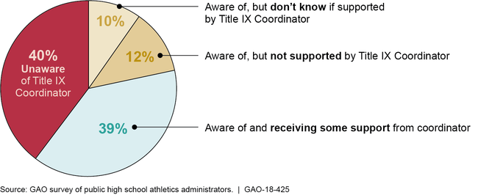
Whose Job Is It, Anyway?
Notes:
Congress enacted Title IX in 1972 with two principal objectives in mind (1) to avoid the use of federal resources to support discriminatory practices and (2) to provide individual citizens effective protection against those practices. When Congress acts pursuant to its spending power, it generates legislation much in the nature of a contract: in return for federal funds, the States agree to comply with federally imposed conditions. "The contractual framework of Title IX distinguishes Title IX from Title VII. Title VII is framed not as a contract but as an outright prohibition and is targeted toward discrimination in the economy. Title IX focuses more on “protecting” individuals from discriminatory practices carried out by recipients of federal funds. Title IX contractual nature stems out of Congress attaching conditions to the award of federal funds under its spending power. For this reason, the Supreme Court found recipients of the federal funds are liable for noncompliance with the conditions.

